Slide 1





THE STEPPING STONE: EMPOWERING YOUTH EMPLOYMENT WITH SMART ECONOMY
Team/ Members: Shermaine & Shi Min
Supervisor: Ms Teo Miow Ting
Institution: Nanyang Polytechnic
Country representative: Singapore
SDG Targets:
8.2, 8.5, 8.6

Slide 2
SDG TARGETS & OBJECTIVE
Objective:
To counter youth unemployment, create opportunities for all and to create a SMART economy
TARGET 8.2 → Achieve higher levels of economic productivity through diversification, technological upgrading and innovation, including through a focus on high-value added and labour-intensive sectors
TARGET 8.5 → By 2030, achieve full and productive employment and decent work for all women and men, including for young people and persons with disabilities, and equal pay for work of equal value
TARGET 8.6 → By 2020, substantially reduce the proportion of youth not in employment, education or training

Slide 3
CURRENT ISSUES
Youth employment
Gender & Age Equality
SMART Economy
RECOMMENDATIONS
REFERENCES
CONTENTS

Slide 4
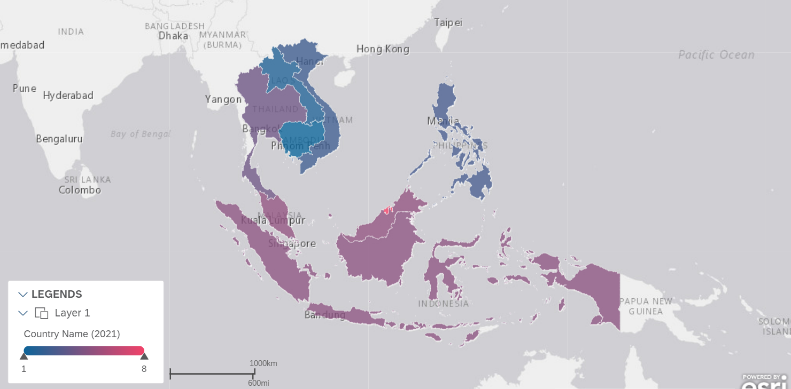

ASEAN’S UNEMPLOYMENT AT A GLANCE
Country | Unemployment Rate
Brunei | 7.64%
Malaysia | 4.6%
Indonesia | 4.41%
Singapore | 3.62%
Thailand | 3.58%
Philippines | 2.4%
Vietnam | 2.16%
Laos | 1.25%
Cambodia | 0.61%
Myanmar | Missing data
From the heatmap, we can see that Brunei hold the highest unemployment rate at 7.64%, while Cambodia holds the lowest unemployment rate at 0.61%.
Source: WorldBank

Slide 5
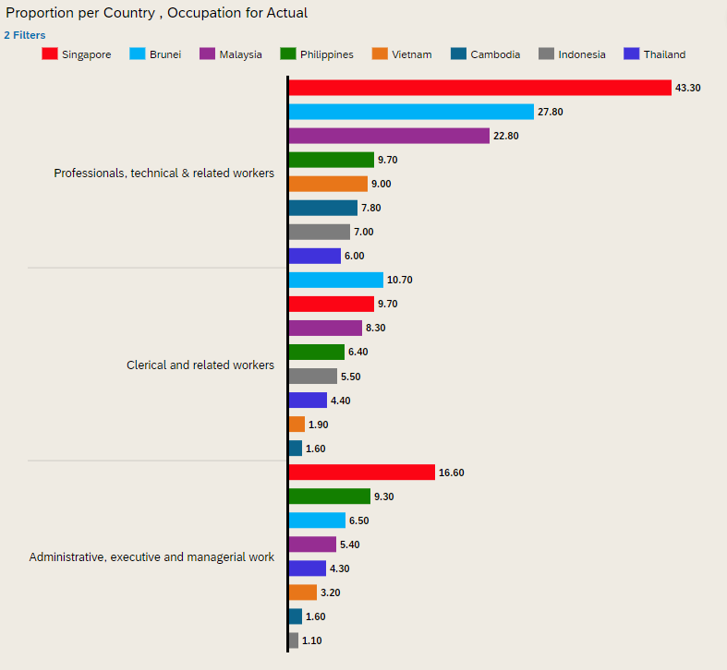
EMPLOYMENT BY OCCUPATION
White-collar Workers
Missing data: Laos & Myanmar
In the previous chart, we see that the unemployment rates vary greatly amongst the ASEAN countries.
However, a low unemployment rate ≠ a good economy.
While Cambodia holds the lowest unemployment rate, they also hold one of the lowest % of workers in white-collar jobs.
On the other hand, Singapore consistently displays high proportion of its population in white-collar jobs, which are less likely to be displaced in the future.
Source: ASYB

Slide 6
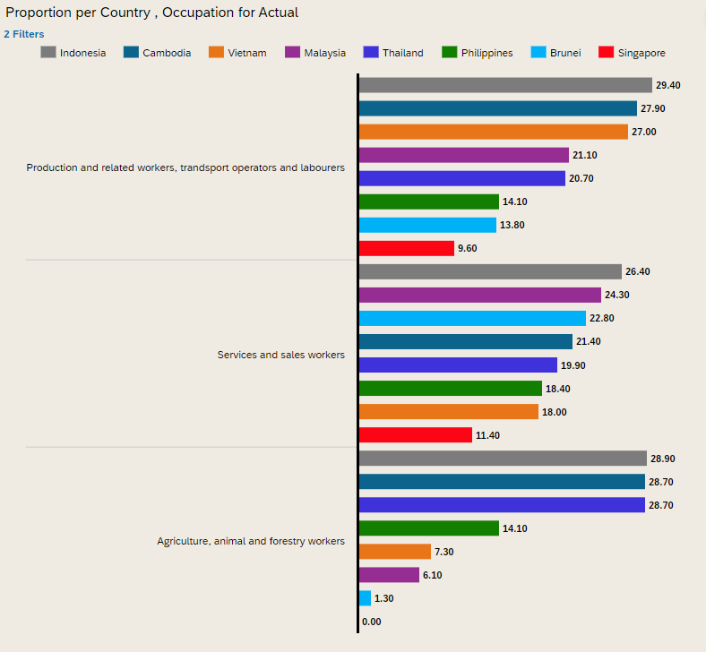
EMPLOYMENT BY OCCUPATION
Blue-collar Workers
Missing data: Laos & Myanmar
Here, we see that while Cambodia has the lowest unemployment rate, it also holds a high proportion of its population in blue-collar jobs.
As we will see later, many of these blue-collar jobs are at very high risks of being displaced in the future of industry 4.0, meaning that countries like Cambodia and Indonesia will reach a drastic drop in employment rates in the near future.
In contrast, while countries like Singapore and Brunei holds a slightly higher unemployment rate, they also have a low proportion of population in blue-collar jobs, reducing the likelihood of workers being displaced in the future.
Source: ASYB

Slide 7
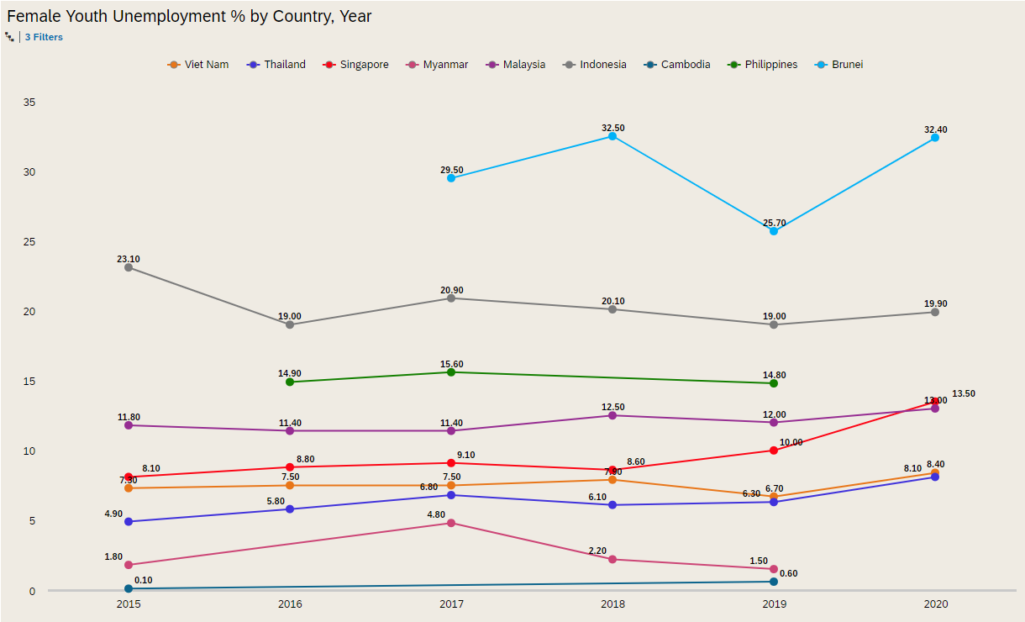
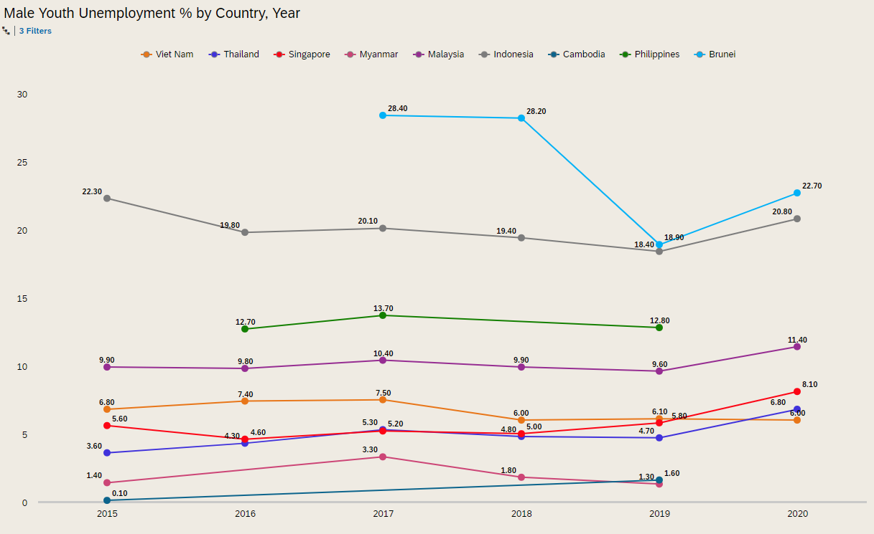
YOUTH UNEMPLOYMENT BY GENDER (Target 8.6)
FEMALES
MALES
From target 8.6, it aims to substantially reduce the proportion of youth not in employment, education or training by 2020. However, although youth unemployment rates have decreased in the past years, we can see from both graphs that they have actually increased in 2020, which we suspect is due to Covid, hence not meeting the target as unemployment rates are still generally quite high amongst all countries.
Missing Data:
Myanmar 2020
Cambodia 2020
Philippines 2020
Source: ILO

Slide 8
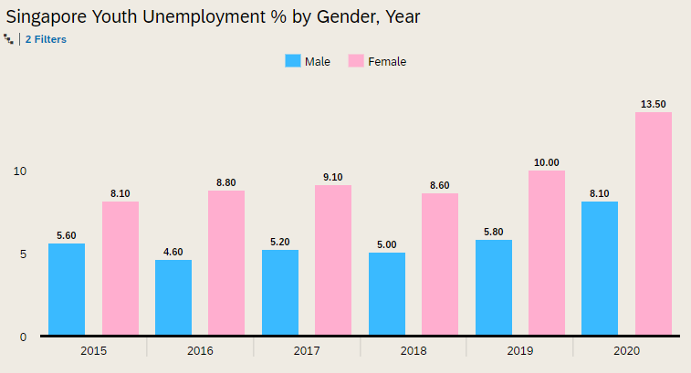
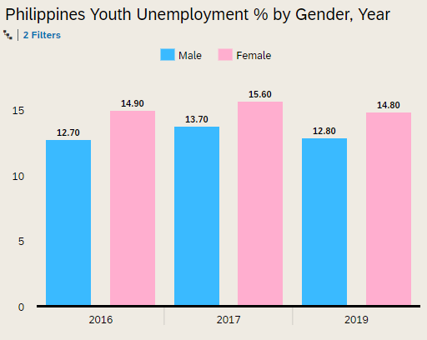
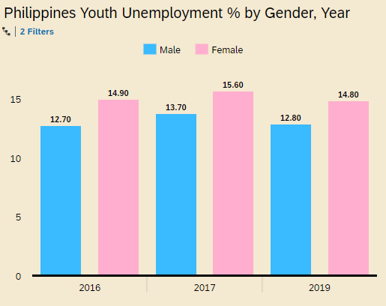
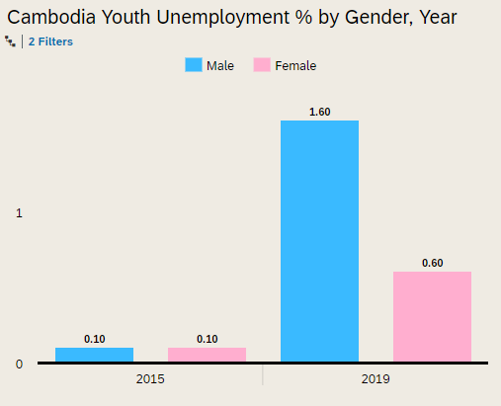
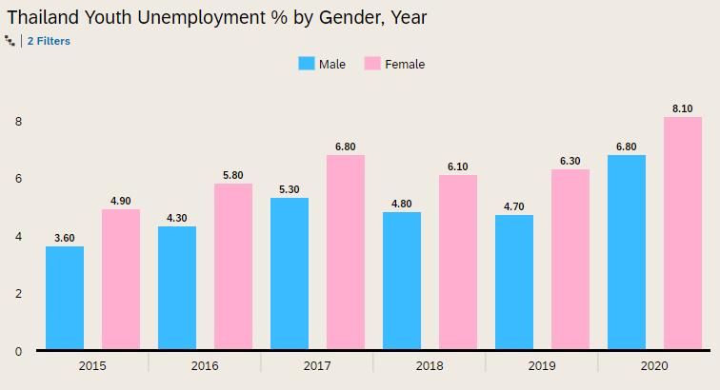
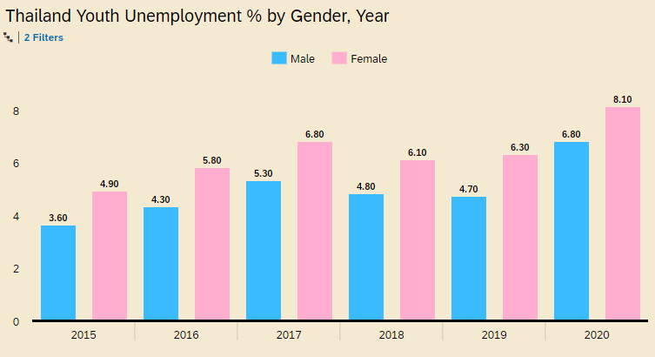
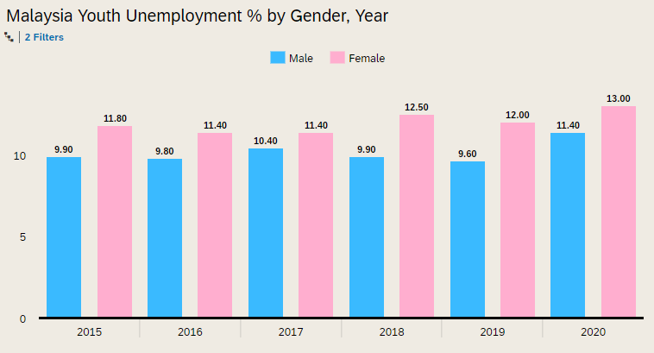
YOUTH UNEMPLOYMENT BY GENDER (Target 8.5)
COMPARISON
Missing Data:
Philippines: 2015, 2018, 2020
Cambodia: 2016, 2017, 2018, 2020
Myanmar: 2016, 2020
Brunei: 2015, 2016
Laos: ALL
Source: ILO

Slide 9
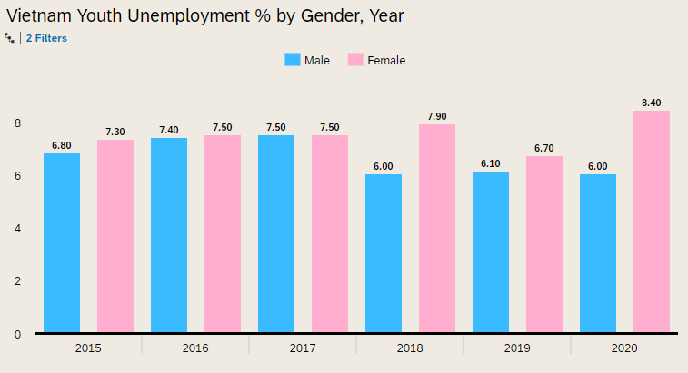
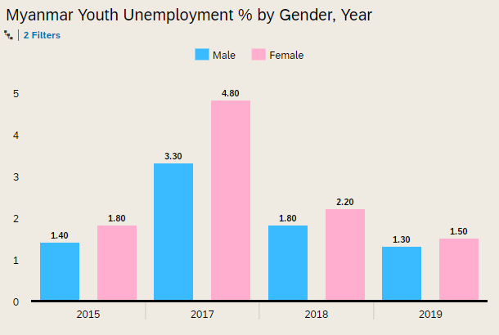
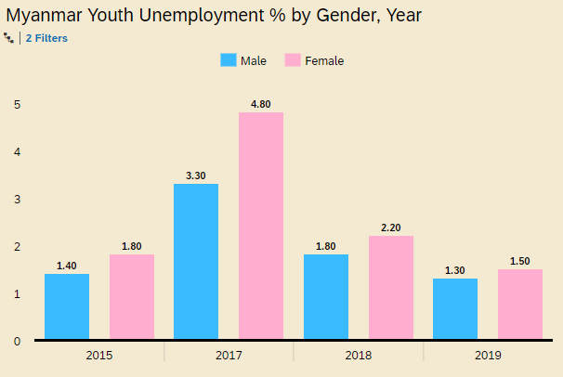
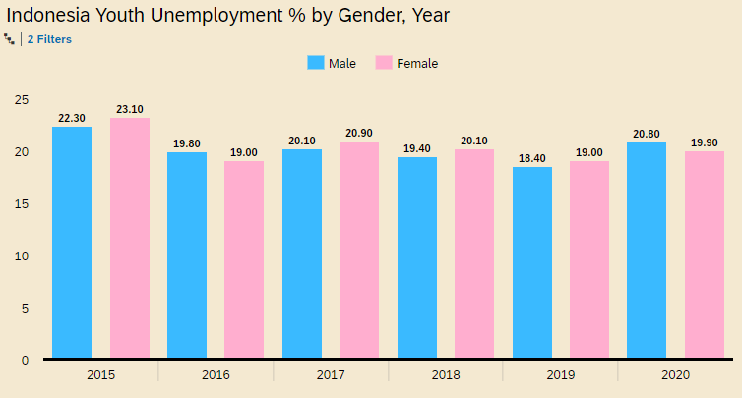
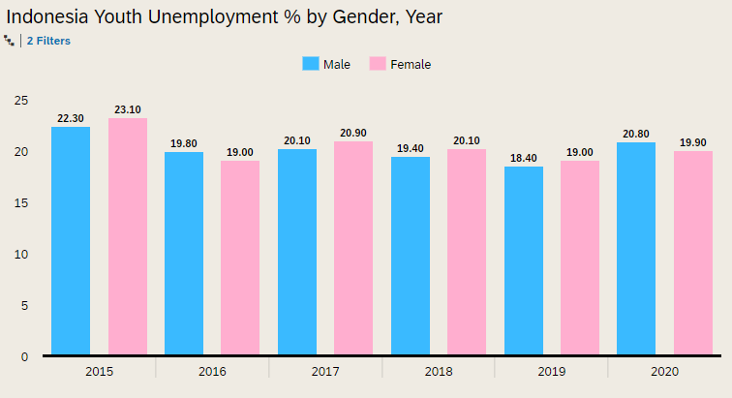
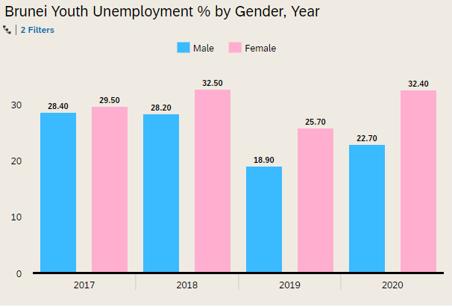
YOUTH UNEMPLOYMENT BY GENDER (Target 8.5)
COMPARISON
These charts show that majority of male unemployment rates are lower than female unemployment rates.
From this, we can see that there is a gender bias that needs to be countered in order to meet the target 8.5 of achieving full and productive employment and decent work for all women and men, including the young by 2030.
Source: ILO

Slide 10
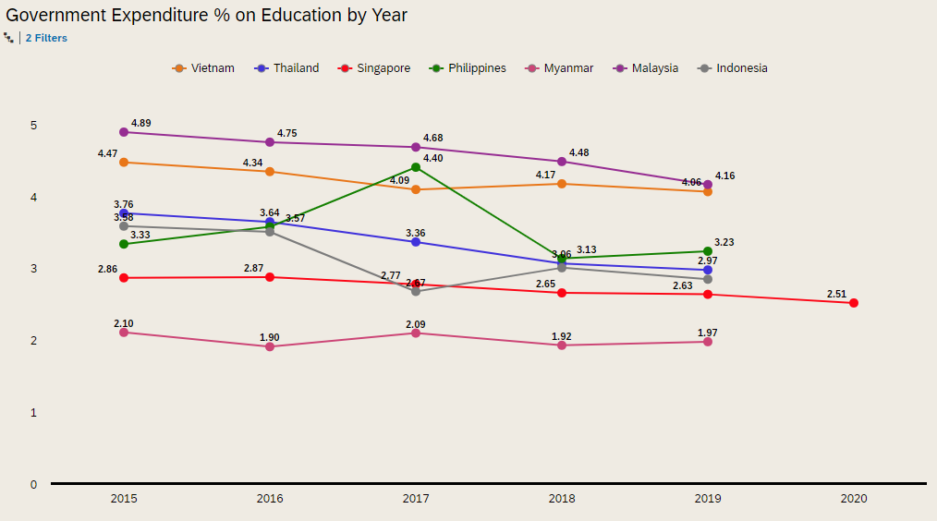
EDUCATION SUPPORT BY GDP (Target 8.6)
From the current graph, we can see a common trend amongst all countries in the decreasing education GDP over the years
Missing Data:
Brunei 2015 - 2020
Cambodia 2015 - 2020
Laos 2015- 2020
Myanmar 2020
Malaysia 2020
Indonesia 2020
Philippines 2020
Thailand 2020
Vietnam 2020
Source: ASYB

Slide 11
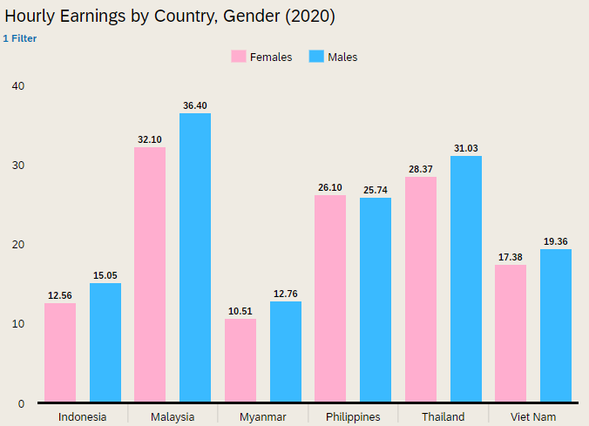
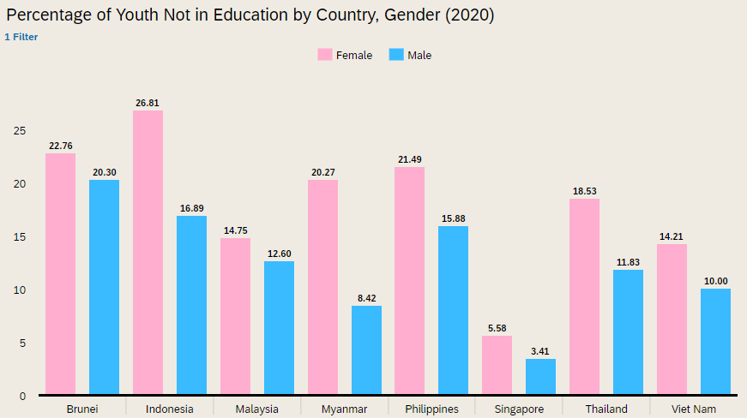
GENDER EQUALITY BY SALARY & EDUCATION (Target 8.5)
Missing Data: Brunei, Cambodia, Laos, Singapore
Missing Data: Cambodia, Laos
From the above 2 graphs, we see that males generally have higher salaries and more education/ training as compared to females, which surfaces the problem of gender bias yet again. In order to meet target 8.5, we believe that equal opportunities for both genders should be provided.
Source: WorldBank & ILO

Slide 12
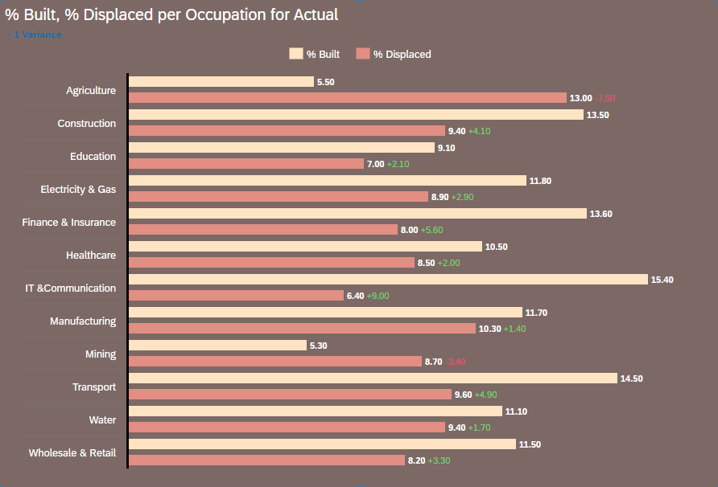
SMART ECONOMY
TECHNOLOGY DISPLACEMENT VS INCOME GROWTH (Target 8.6)
In the building of industry 4.0, we see that many jobs have been displaced. However, we can also see an increase in the number of jobs built. From here, we can determine the occupations that will face high unemployment, such as agriculture and mining, in the coming years.
However, jobs like IT & Communication show a large increase in job opportunities over the years. Hence, this shows that educational focus should also lean toward occupations that will provide jobs in the future
Source: Cisco

Slide 13
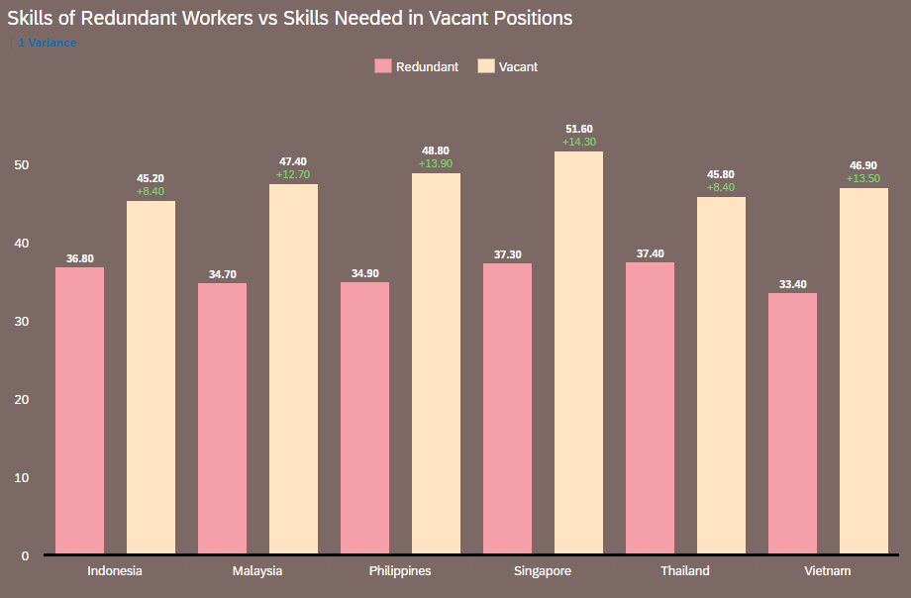
SMART ECONOMY SKILLS MISMATCHED (Target 8.2)
Lastly, from this graph, we see the percentages of redundant skills, which leads to unemployment and vacant job opportunities. Clearly, there are still many vacant job opportunities, but lack the right skilled workers to be fulfilled. On the other hand, there are many redundant jobs that are being replaced over the years, leading to unemployment.
Hence, we believe that while education itself is important, teaching and attaining the right skillset, useful for the future of industry 4.0 is even more important
Source: Cisco

Slide 14


RECOMMENDATIONS
Government Investment in Education
Governments should invest more in education.
As seen, while unemployment rates are not decreasing, the education support has decreased over the years. Without proper education, it is hard for youths to be employed, hence, education support should increase.
Drive Students in the Right Education Pathway
Lastly, it is evident that there are many job vacancies available and that technology is overtaking the current generation, hence, we believe that more education should be provided towards the right industry, so youths entering the workforce would not have their jobs displaced
Promote Gender Equality
As seen from the gender equality, males generally have more education and higher pay as compared to females. This can cause lesser women to want to be in the workforce, hence worsening the economy due to lack of skilled workers
ONE VISION,
ONE IDENTITY,
ONE COMMUNITY

Slide 15
REFERENCES
ASEAN Statistical 2021 Yearbook (ASYB)
International Labour Organisation Stat (ILOSTAT)
Technology and the future of ASEAN jobs by Cisco and Oxford Economics
World Bank Open Data

